Slide 1

Multivariate Analysis & PCA
ISL Presentation
John Nolan, FSAI

Slide 2
Agenda
Multivariate Analysis:
Intro
Simpson’s Paradox
Techniques Used - PCA
Simple Example

Slide 3
Multivariate Analysis - Intro
Three types of analysis:
Univariate analysis
The examination of the distribution of cases on only one variable at a time (e.g. college graduation)
Bivariate analysis
The examination of two variables simultaneously (e.g. the relationship between gender and college graduation)
Multivariate analysis
The examination of more than two variables simultaneously (e.g., the relationship between gender, race, and college graduation)
Multivariate Analysis allow the separate and combined effects of the independent variable to be examined

Slide 4
Multivariate Analysis – Simpson’s Paradox
Using Simpson’s Paradox to show why Multivariate analysis is necessary
Simpson's paradox occurs when groups of data show one particular trend, but this trend is reversed when the groups are combined together.
Example:
44% of male applicants are admitted by a university, but only 33% of female applicants
Men more likely to get admitted? Difference too large to be down to chance
Does this mean there is unfair discrimination?
University decided to investigate by further breaking down by degree

Slide 5
Multivariate Analysis – Simpsons Paradox
Results by degree:
→ No relationship between sex and acceptance for either programme, i.e. no discrimination
Why?
More females apply for English programme, but it is hard to get in to (25% success)
More males apply for engineering, but it is easier to get in to (50% success)
Degree is the confounding variable
Demonstrates why we shouldn’t just scratch the surface.

Slide 6
Multivariate Analysis – What’s its all about?
Definition:
“The simultaneous analysis of several variables”
MVA uses ALL available data to capture the most information possible. Never a simple uni/bivariate analysis.The basic principle is to boil down hundreds of variables to a mere handful.
Making sense of large mases of data -> Data-rich but knowledge poor.
Multivariate analysis can help summarise the data and avoid spurious results as seen in previous examples.
MVA is based on “Ockham’s Razor”:
"Everything should be kept as simple as possible, but no simpler.“
Simpson’s paradox shows how we need to consider more variables, Ockham’s Razor tells us to consider less… Need to find a balance.

Slide 7

Multivariate Analysis – Example
Apples Versus Oranges
Could come up with 100’s of different factors to compare them:
Colour, shape, texture, firmness, …
Skin: smoothness, thickness,…
Juice: PH, taste, composition
Seeds, etc.
Ultimately, there will never be more than one difference: is it an apple or an orange?

Slide 8
Multivariate Analysis – Techniques
Many different techniques used to perform a multivariate analysis:
Principal Component Analysis (PCA)
Singular Value Decomposition (SVD)
Multiple regression
Logistic regression
Discriminant Analysis
Multivariate Analysis of Variance (MANOVA)
Most of these are pretty complex, with heavy maths behind them

Slide 9
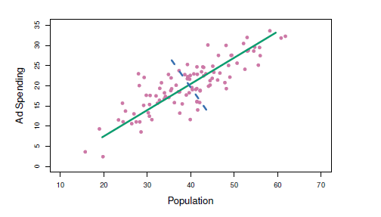
Multivariate Analysis – Principal Component Analysis (PCA)
Used to identify the underlying dimensions or “Principle Components” for sources of variation.
An unsupervised learning algorithm, it finds patterns by itself. In particular, PCA finds (mutually orthogonal) directions of greatest variance.
The green solid line indicates the first principal component direction, and the blue dashed line indicates the second principal component direction.
Essentially finding new variables that are linear functions of those in the original dataset, that successively maximize variance and that are uncorrelated with each other

Slide 10


Multivariate Analysis – Principal Component Analysis (PCA)
Form of data compression without much loss of information
First principle component accounts for as much of the variability as possible, and each succeeding component accounts for as much of the remaining variability as possible.
…. Reduces effect of multi-collinearity.
Refers to predictors that are correlated with other predictors.
Occurs when model includes multiple factors that are correlated to both response and other variables
Results when you have factors that are a bit redundant.

Slide 11
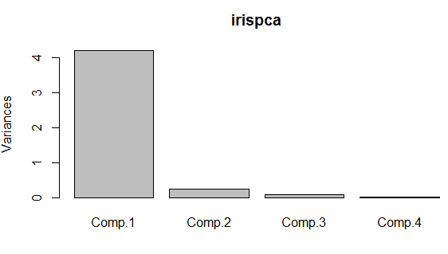
Multivariate Analysis – Principal Component Analysis (PCA)
Can be performed in R using prcomp(dataset) or princomp(dataset)
Create a scree plot:
“A scree plot displays the proportion of the total variation in a dataset that is explained (PVE = Proportion of Variance Explained) by each of the components in a principle component analysis. It helps you to identify how many of the components are needed to summarise the data.”
See R code for example “10.4 Lab 1: Principal Components Analysis”

